Slide 1
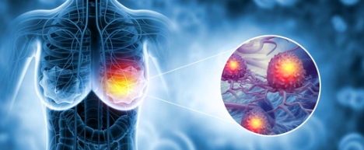
Breast cancer Multiclassification
Using Transfer learning
Leona Chazanga

Slide 2

Introduction
Global Impact
Breast cancer is the most diagnosed cancer and leading cause of cancer death among women worldwide.
Biological Heterogeneity
A heterogeneous group of tumors with variations in clinical presentation, morphology, and biological behavior (Rakha, 2022).
Classification Foundation
Histomorphological classification provides critical diagnostic and prognostic information for all other systems (Rakha, 2022).
The AI Revolution
AI, ML, and DL improve diagnostic accuracy, reduce evaluation time, and uncover complex patterns (Dur Karasayar et al, 2025).
AI is transforming patient care by optimizing treatment and improving clinical outcomes.

Slide 3
Problem Statement
The Need for AI Solutions
Breast cancer subtypes are difficult to distinguish due to high intra-class variability and inter-class similarity in histopathological images.
There is a critical need for AI systems to:
Efficiently and accurately classify tumor types.
Improve diagnostic accuracy.
Reduce processing time for images.
Diagnostic Challenges
Classification currently relies heavily on the performance and expertise of pathologists. Key challenges include:
Differentiation between in situ and invasive cancer.
Tumor typing and grading complexity.
Distinguishing primary cancers from their mimics.
Developing AI tools addresses the variability and complexity issues in current diagnostic workflows.

Slide 4
Objectives
Model Development
To develop a machine learning model for multiclass classification of breast cancer subtypes using breast histopathology images
Performance Evaluation
To evaluate the model performance
Model Interpretability
To use Gradient-weighted Class Activation Mapping (Grad-CAM) to visualize image sections influencing model classification decisions.
Clearly defined goals ensure technical precision and meaningful clinical outcomes.

Slide 5
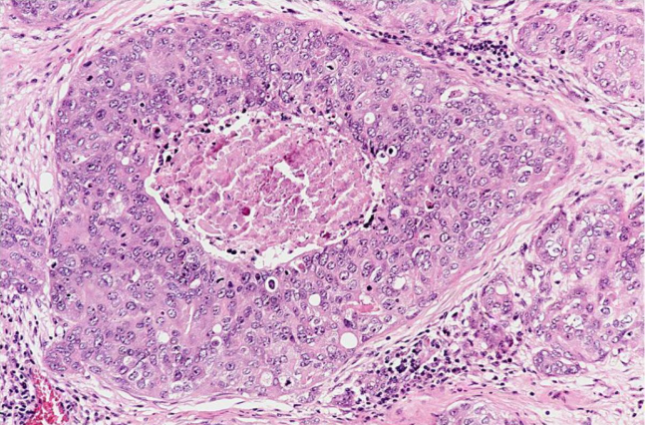
Dataset: BreaKHis
Description of the Dataset
BreaKHis dataset containing 2,081 breast cancer histopathology images at 100X magnification.
check_circle
Class: Benign
Adenosis (A)
Fibroadenoma (F)
Phyllodes tumor (PT)
Tubular adenoma (TA)
warning
Class: Malignant
Ductal carcinoma (DC)
Lobular carcinoma (LC)
Mucinous carcinoma (MC)
Papillary carcinoma (PC)
Categorizing images into specific subtypes is essential for accurate multi-class classification.

Slide 6
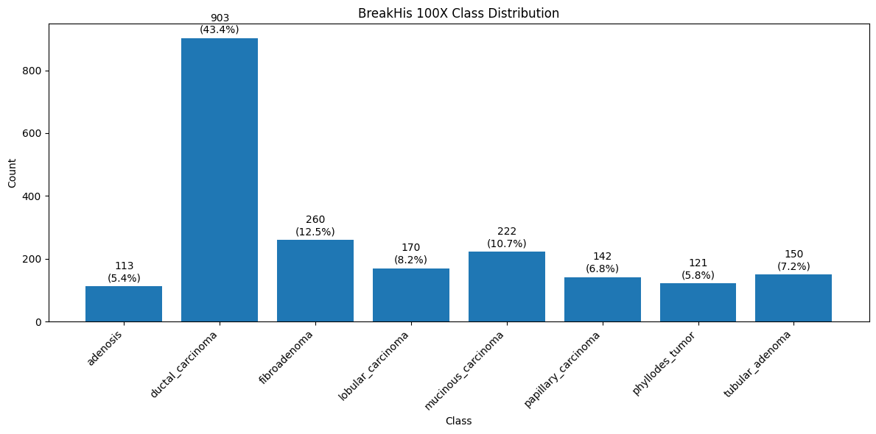
Data distribution by class

Slide 7
Data Preprocessing
Image Resizing & Tensor Conversion
Images resized to 160 × 160 pixels. Converted to tensors for model compatibility.
Data Augmentation
Techniques include flipping and colour adjustments to improve model robustness.
Normalization
Using standard ImageNet parameters: Mean: [0.485, 0.456, 0.406] | Std Dev: [0.229, 0.224, 0.225].
Class Balancing
Implemented via WeightedRandomSampler to address dataset imbalances.
Dataset Splitting
Stratified split used for train, validation, and test sets to maintain class proportions.
Comprehensive preprocessing ensures the data is optimized for high-performance deep learning models.

Slide 8
Machine Learning Methodology
Data Partitioning & Transfer Learning
Data Splitting: Training (70%), Validation (15%), Test (15%) | Split Sizes: Train (1456), Val (312), Test (313)
Utilized Transfer Learning with ImageNet pretrained models as the foundation.
ResNet-50
A deep CNN with 50 layers leveraging residual connections. This architecture allows training of extremely deep models while preventing information loss during backpropagation.
DenseNet121
Features dense connections where every layer connects to all subsequent layers. This promotes feature reuse and efficient gradient flow, excelling at capturing fine image details.
EfficientNet-B0
A high-efficiency CNN that uses balanced scaling of depth, width, and resolution. Achieves superior accuracy with significantly fewer parameters than traditional models.

Slide 9
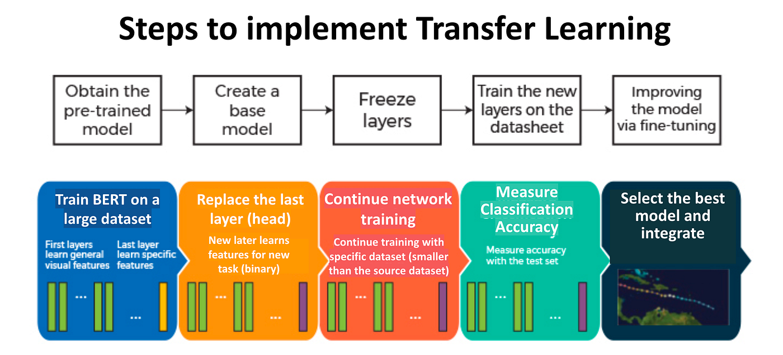

Slide 10
Baseline Model Performance
DenseNet121 (best model at baseline)
Accuracy | Precision | Recall | F1-score | ROC-AUC | Loss
0.6741 | 0.6465 | 0.6626 | 0.6375 | 0.9440 | 0.9289
The baseline model had performance metrics ranging between 63% and 67%.
Showed poor performance with need to improve using fine tuning.

Slide 11
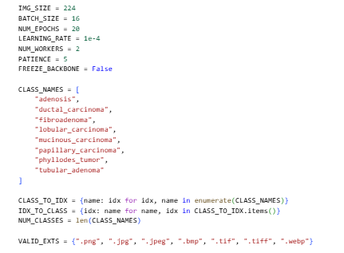
Model Fine-Tuning Parameters
Optimization Strategy
Image Resizing: Standardized to 224×224 pixels.
Batch Size: 16 images per iteration for stable gradients.
Epochs: Increased from 10 to 20
Learning Rate: Set to a small 1e-4 for precise weight updates.
Data Loading: NUM_WORKERS=2 for parallelized processing.
Early Stopping: PATIENCE=5 prevents overfitting by halting if no improvement is seen.
Fine-Tuning: FREEZE_BACKBONE enables training of the entire model except the final layer.

Slide 12
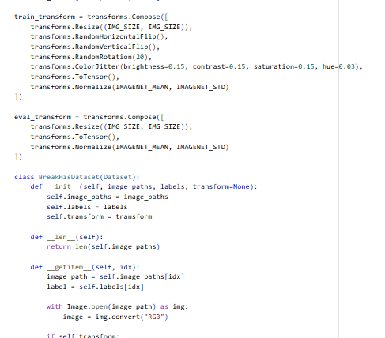
Data Transformation
Resize: Images are resized to 224×224.
RandomHorizontalFlip: Flips images randomly to increase data diversity.
RandomRotation(20): Rotates images slightly (±20°).
ColorJitter: Changes brightness, contrast, saturation to simulate staining variations.
ToTensor(): Converts image to numerical format (0–1 scale).
Normalize(): Standardizes pixel values for ImageNet compatibility.
Data augmentation was applied to prevent overfitting and improve generalization.
It also makes model more robust to variations.

Slide 13
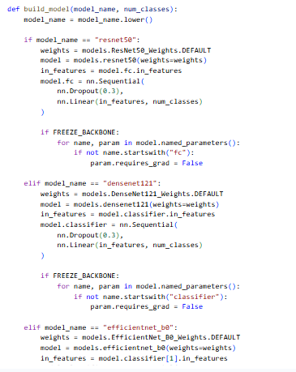
Models
ResNet50, DenseNet121 and EfficientNetB0 were used
Dropout rate is set at 0.3 to prevent overfitting
Linear layer outputs 8 classes of the tumors adapting the model to classification task
Freeze-Backbone freezes all layers except the final classifier whilst earlier layers keep pretrained knowledge

Slide 14
Fine Tuned Model Performances
Test Set Performance Matrices
Model | Accuracy | Precision | Recall | F1-scores | ROC-AUC | Loss
DenseNet121 | 0.904153 | 0.908120 | 0.895719 | 0.899851 | 0.993629 | 0.266918
ResNet 50 | 0.907348 | 0.895239 | 0.905233 | 0.898408 | 0.994942 | 0.242928
EfficientB0 | 0.891374 | 0.881264 | 0.890166 | 0.884461 | 0.993409 | 0.254668
All models demonstrated strong performance, with accuracies ranging from approximately 89% to 91% and very high AUC values of approx. 0.99.
High ability to distinguish between breast cancer subtypes.
ResNet-50 achieved the highest overall accuracy (0.9073), recall (0.9052), and AUC (0.9949), indicating it performs best in correctly identifying true cases and has the strongest class separability.

Slide 15
Comparison to other model performance
Model | Accuracy | Precision | Recall | F1-scores | ROC-AUC | Loss
DenseNet121 | 0.904153 | 0.908120 | 0.895719 | 0.899851 | 0.993629 | 0.266918
ResNet 50 | 0.907348 | 0.895239 | 0.905233 | 0.898408 | 0.994942 | 0.242928
EfficientB0 | 0.891374 | 0.881264 | 0.890166 | 0.884461 | 0.993409 | 0.254668
DenTnet (Wakili et al, 2022) |  | 0.9700 |  | 0.9948 | 0.99
ResRFSAM-LSTM (Wang et al, 2024) | 97.08 | 95.87 | 95.87 | 95.87
Xception (Ashrov et al, 2023) | 98.5
ResNet50(Ashrov et al, 2023) | 98.1
models had fairly good performance compared to the models from reference literature

Slide 16
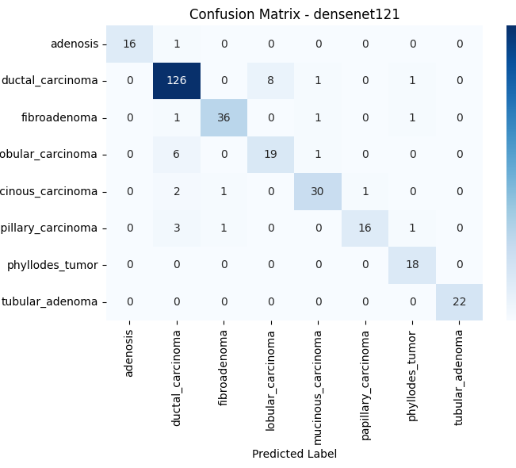
Confusion Matrix
High Overall Accuracy
Most predictions are on the diagonal.
Strong Performers
Classified very well: Ductal carcinoma, phyllodes tumor, tubular adenoma.
Areas of Confusion
Minor errors in fibroadenoma and mucinous carcinoma.
Main confusion: lobular carcinoma vs. ductal carcinoma.
Errors due to similar histopathology features.
Conclusion: Strong and reliable performance

Slide 17
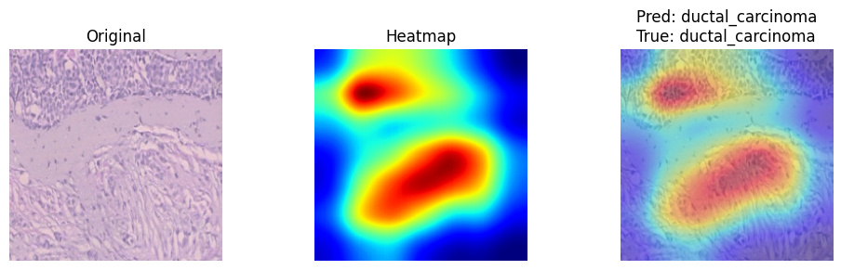
GradCAM of correctly classified images
Feature Localization
GradCAM shows important regions and highlights tumor-relevant areas.
Model Explainability
Ensures model is learning meaningful features, critical for medical explainability.

Slide 18

Conclusion
Developed a multiclass deep learning model for breast cancer classification
Achieved approximately 90% accuracy with strong F1-scores after fine-tuning
DenseNet121 performed best overall, ResNet-50 achieved highest accuracy/AUC and the best clinical model
Grad-CAM confirmed model focuses on relevant tumor regions
Demonstrates strong potential of AI for cancer histopathology image processing
Demonstrated effectiveness of transfer learning, preprocessing and model comparison in medical image processing
Future work- improve generalization and expand dataset
Future work
improve generalization and expand dataset Increase number of epochs to improve generalization
Expand dataset
Apply advanced augmentation techniques
Deploy model for clinical use

Slide 19
References
Wang G, Jia M, Zhou Q, et al. Multi-classification of breast cancer pathology images based on a two-stage hybrid network. J Cancer Res Clin Oncol. 2024;150(12):505. Published 2024 Nov 18. doi:10.1007/s00432-024-06002-y
Ashurov A, Chelloug SA, Tselykh A, Muthanna MSA, Muthanna A, Al-Gaashani MSAM. Improved Breast Cancer Classification through Combining Transfer Learning and Attention Mechanism. Life (Basel). 2023;13(9):1945. Published 2023 Sep 21. doi:10.3390/life13091945
Gandomkar Z, Brennan PC, Mello-Thoms C. MuDeRN: Multi-category classification of breast histopathological image using deep residual networks. Artif Intell Med. 2018;88:14-24. doi:10.1016/j.artmed.2018.04.005
Wakili MA, Shehu HA, Sharif MH, et al. Classification of Breast Cancer Histopathological Images Using DenseNet and Transfer Learning. Comput Intell Neurosci. 2022;2022:8904768. Published 2022 Oct 10. doi:10.1155/2022/8904768
Łukasiewicz S, Czeczelewski M, Forma A, Baj J, Sitarz R, Stanisławek A. Breast Cancer-Epidemiology, Risk Factors, Classification, Prognostic Markers, and Current Treatment Strategies-An Updated Review. Cancers (Basel). 2021;13(17):4287. Published 2021 Aug 25. doi:10.3390/cancers13174287

Slide 20
References
Conti M, Morciano F, Amodeo S, Gori E, Romanucci G, Belli P, Tommasini O, Fornasa F, Rella R. Special Types of Breast Cancer: Clinical Behavior and Radiological Appearance. Journal of Imaging. 2024; 10(8):182. https://doi.org/10.3390/jimaging10080182
Rakha EA, Tse GM, Quinn CM. An update on the pathological classification of breast cancer. Histopathology. 2023;82(1):5-16. doi:10.1111/his.14786
Dur Karasayar AH, Kulaç İ, Kapucuoğlu N. Advances in Breast Cancer Care: The Role of Artificial Intelligence and Digital Pathology in Precision Medicine. Eur J Breast Health. 2025;21(2):93-100. doi:10.4274/ejbh.galenos.2025.2024-12-8
F. A. Spanhol, L. S. Oliveira, C. Petitjean and L. Heutte, "A Dataset for Breast Cancer Histopathological Image Classification," in IEEE Transactions on Biomedical Engineering, vol. 63, no. 7, pp. 1455-1462, July 2016, doi: 10.1109/TBME.2015.2496264.
Hasan N, Bao Y, Shawon A, Huang Y. DenseNet Convolutional Neural Networks Application for Predicting COVID-19 Using CT Image. SN Comput Sci. 2021;2(5):389. doi:10.1007/s42979-021-00782-7
Feng M, Cai Y, Yan S. Enhanced ResNet50 for Diabetic Retinopathy Classification: External Attention and Modified Residual Branch. Mathematics. 2025; 13(10):1557. https://doi.org/10.3390/math13101557
Hoang V T, Jo K H. Practical analysis on architecture of EfficientNet. In: Proceedings of the 14th International Conference on Human System Interaction (HSI); 2021; Gdańsk, Poland. p. 1-4. doi:10.1109/HSI52170.2021.9538782.

